Slide 1
Financial Analytics
of Stock Return
During Market Shock
of Early 2022
Yipeng (Caroline) Guo

Slide 2
01
Risk Exposures

Slide 3
Data
Datasets used here
Fama-French monthly risk factor data (2017 - 2021)
Stock Return (2017 - 2021)
Tickers
Sample Size
1,886 * 60 = 113,160 (entries)
4 columns
Dealing With Strange Values
There are 114,715 entries in Stock Return set
Remove the entries with null in ‘Ticker’ column
Filter out those entries with ticker symbol not in Russel 3000 and delete them

Slide 4
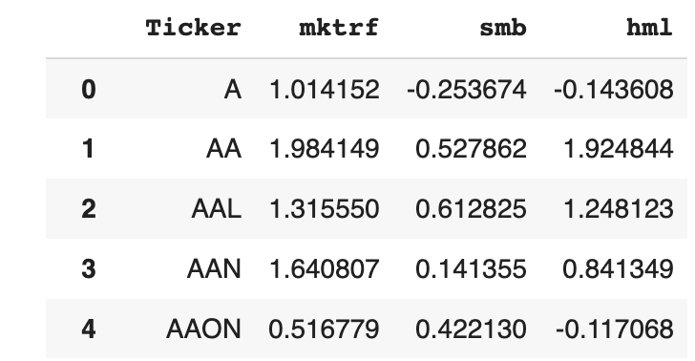
Data
SAMPLE
VARIABLES
mktrf - market exposure comes from CAPM model
smb - small minus big - size exposure
hml - high minus low - value exposure

Slide 5
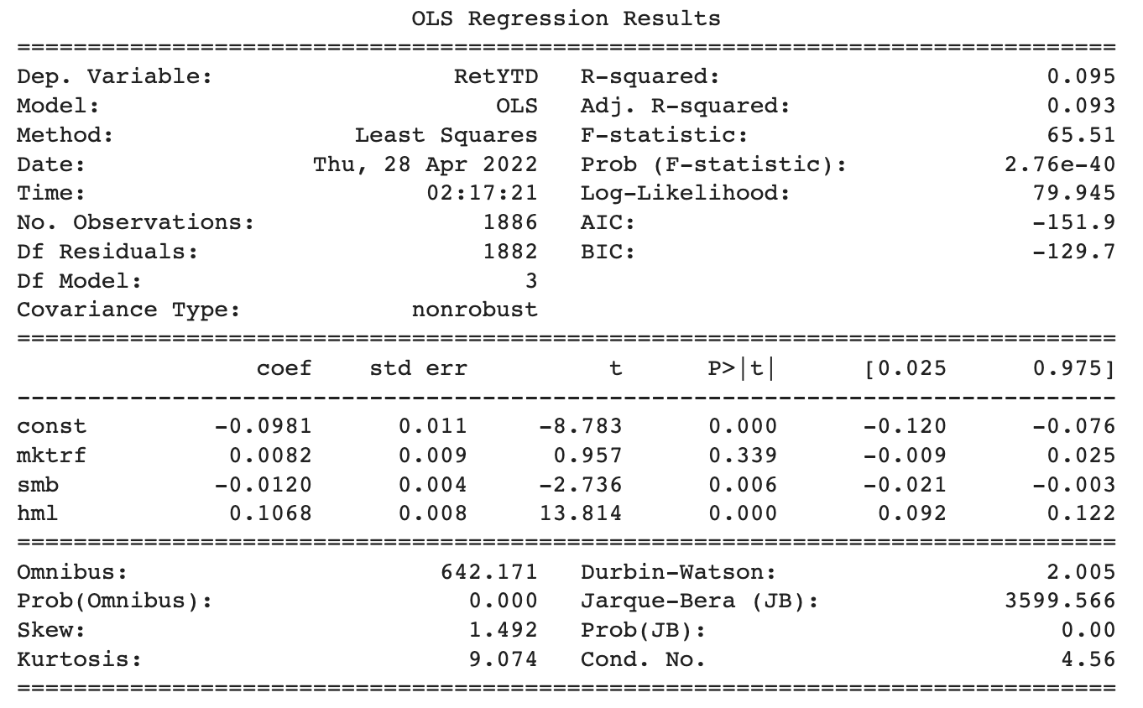
OLS Regression Results

Slide 6
OLS Regression Results
Regression result
> Ret(i) = - 0.0981 + 0.0082 * mktfr - 0.0120 * SMB + 0.1068 * HML
Market of large companies & valued companies.
R-squared & Adj. R-squared
> The value of R-squared is `9.5%` and the Adj. R-squared is `9.3%` , indicating about 9.3% of the stock’s return is explained by the risk exposure measurements. It is relatively low.

Slide 7
02
Financial
Ratios

Slide 8
Data
Datasets used here
Financials
Tickers
Sample Size
1,886 * 12 (self - generated financial ratios)
Dealing With Strange Values
Fill missing values with average
Winsorize as (0.02, 0.98)

Slide 9
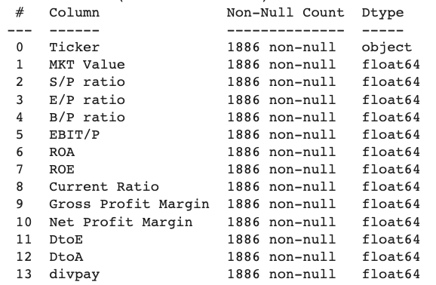
Data
SAMPLE
VARIABLES
Market related
Return related
Profitability related
Solvency related
Valuation related
Notes:
Price to sales ratio
Price to earnings ratio
Price to book ratio
Price to ebit <- get reverse of all the four market related ratios to make them better performed

Slide 10
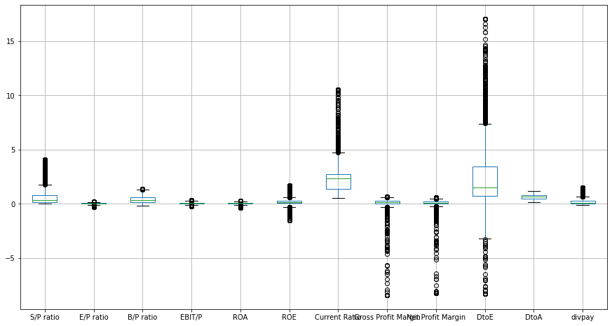
Data - Boxplot After Winsorization (0.02, 0.98)

Slide 11
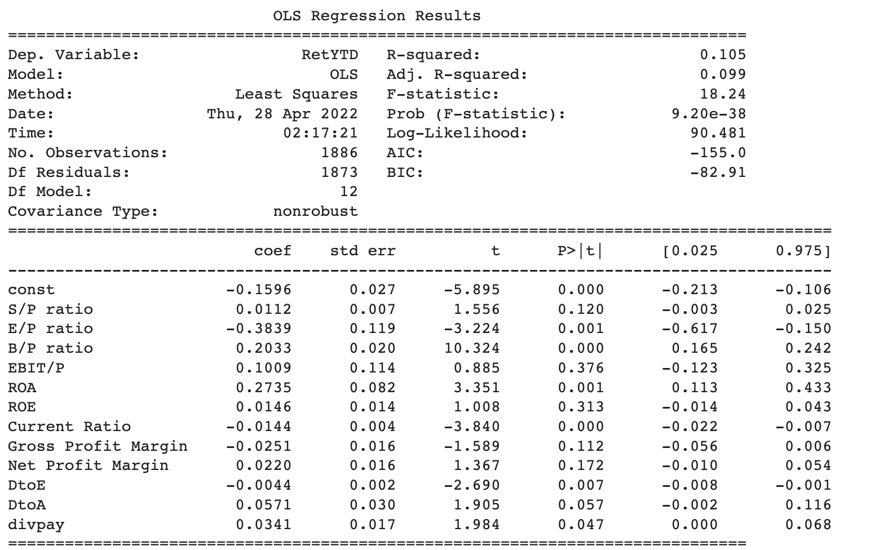
OLS Regression Results

Slide 12
OLS Regression Results
Coef
> - The betas of those 4 market related ratios are mostly `positive`, indicating that increasing market value of the company, will correspondingly increase those ratios, hence do good to the stock returns.
> - The betas of those 2 return related ratios are `positive`, indicating increase EBIT (earnings) will increase the company's stock return.
> - The beta of Net Profit Margin is `0.0220`, suggesting increasing Net Profit will increase the company's stock return.
> - The betas of those 2 solvency related ratios are `positive`, indicating increasing the company's debt payment ability will increase its stock return.
> - The beta of divpay ratio is `0.0341`, indicating increasing the company's valuation will increase its stock return.
Notes:
In a word, increasing the company's profitability, solvancy, return, and valuation can always increase its stock return. This is quite natural - Behave yourself, gain reputation, and make money.

Slide 13
OLS Regression Results
- R-squared & Adj. R-squared
> The value of R-squared is `10.5%` and the Adj. R-squared is `9.9%` , indicating about 9.9% of the stock’s return is explained by the financial ratio measurements. It is relatively low.

Slide 14
03
Industry Indicators

Slide 15
Data
Datasets used here
Industry indicators
Tickers
Sample Size
1,886 * 24
Dealing With Strange Values
No strange values here

Slide 16
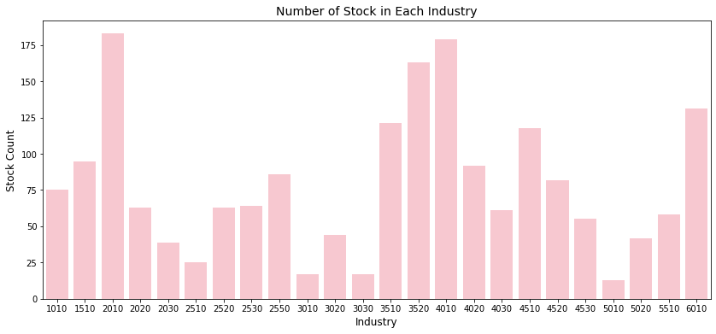
Data
Notes:
2010 - capital goods
4010 - banks
3520 - Pharmaceuticals, Biotechnology & Life science
6010 - Real Estate
3510 - Healthcare equipment and services

Slide 17
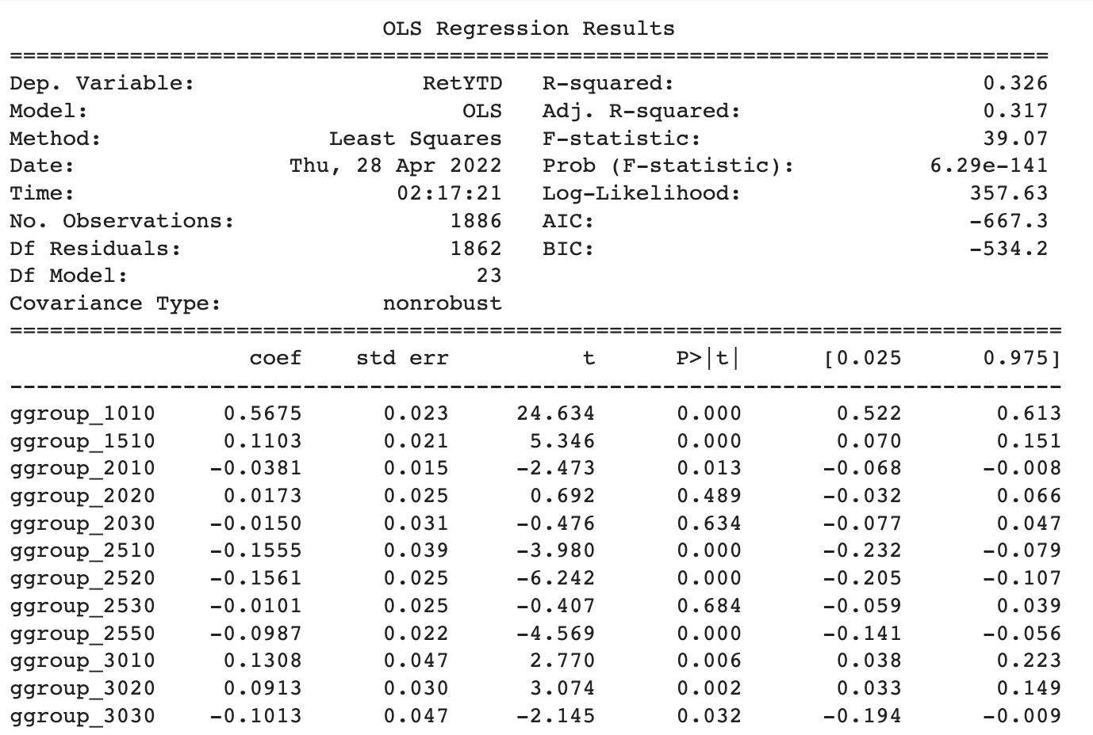
OLS Regression Results - Baseline
Notes:
1010 - Energy

Slide 18
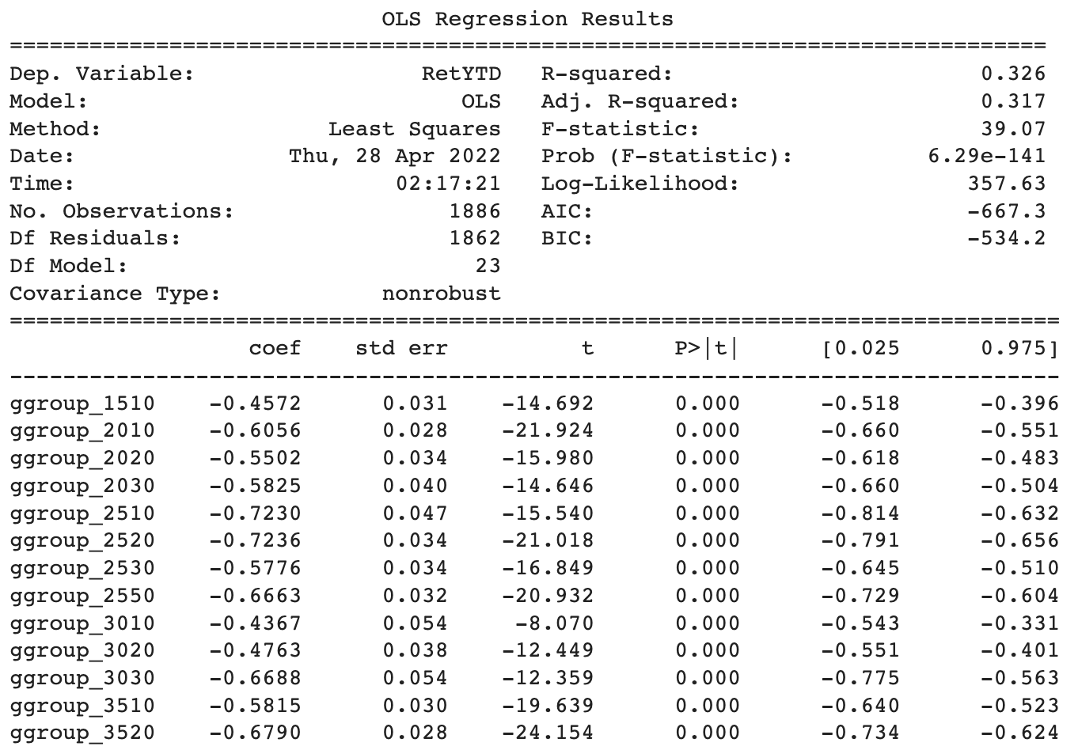
OLS Regression Results - Drop 1010
Notes:
According to this fixed effect regression, we also checked those coefficient - removing ggroup_1010 results in a drastic change of all the industry indicators. Hence ggroup_1010 has large impacts on different industries for 2022.

Slide 19
04
Combined
Regression

Slide 20
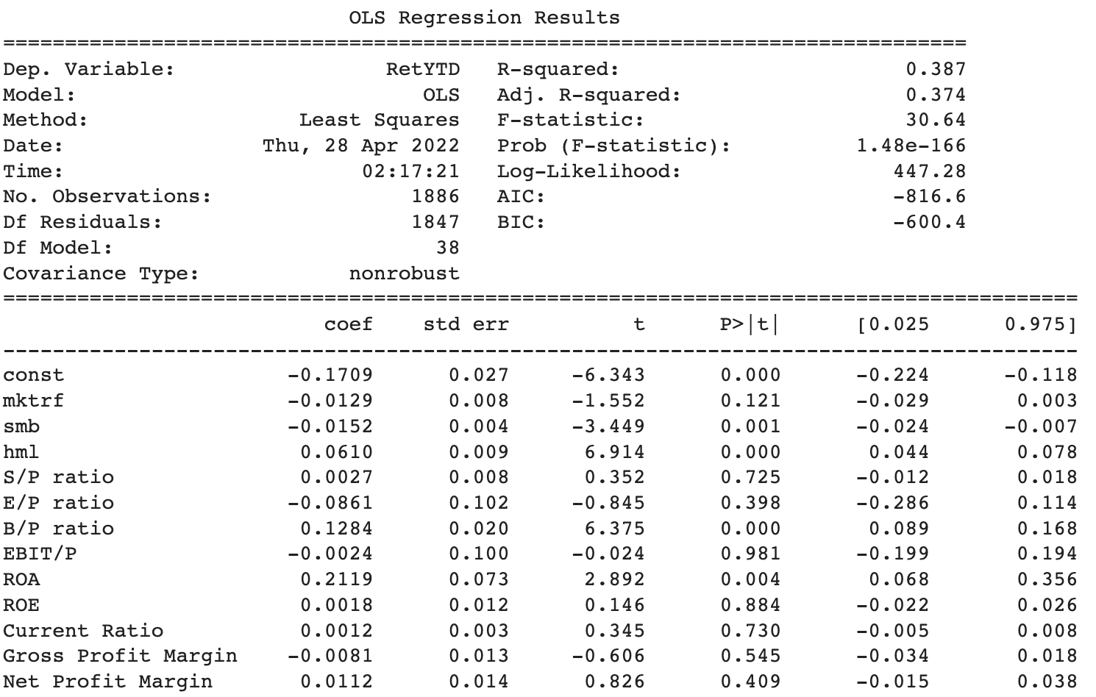
OLS Regression Results

Slide 21
OLS Regression Results
R-squared & Adj. R-squared
> The value of R-squared is `38.7%` and the Adj. R-squared is `37.4%` , indicating about 38% of the stock’s return is explained by the all the three different measurements.
> It is better than any of the single factor regression model before.

Slide 22
To
Conclude…
Market of large companies and valued companies.
Increase market value, earnings, net profit, debt payment ability & dividend payment ability can increase stock return.
Capital, healthcare, life science related companies accounts for most of the companies, but they don’t account much for the stock return;
Conversely, Energy (1010) and Food, Staples & Retailing (3010) are affecting both the stock returns and other industries.

Slide 23
Thanks!

